Slide 1
Lecture 24: Generative Learning Algorithms
Instructor: Yang Xu

Slide 2
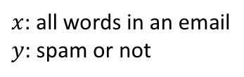
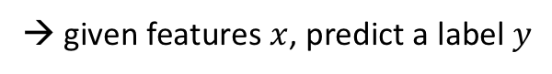
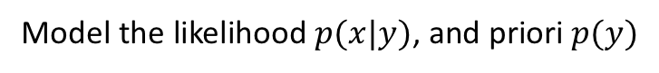
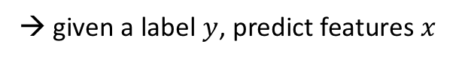
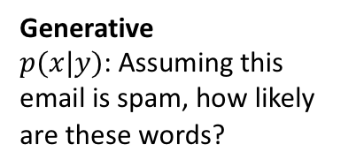
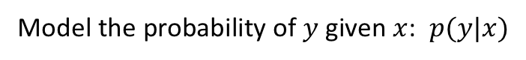
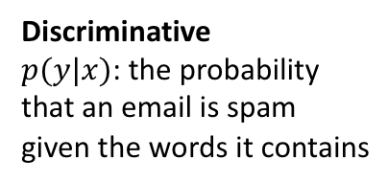
Supervised learning algorithms: discriminative vs. generative
Discriminative learning algorithms:
$x$: all words in an email
$y$: spam or not
Try to classify data
→ given features $x$, predict a label $y$
Model the probability of $y$ given $x$: $p(y|x)$
Discriminative
$p(y|x)$: the probability that an email is spam given the words it contains
Example: logistic regression, $p\left(y=1 | x\right)=σ(w^{T}x+b)$
Generative learning algorithms:
Generative
$p(x|y)$: Assuming this email is spam, how likely are these words?
Map features to labels
→ given a label $y$, predict features $x$
Model the likelihood $p(x|y)$, and priori $p(y)$

Slide 3
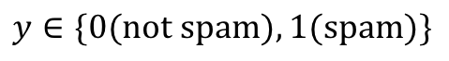
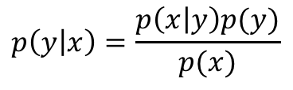
Generative approach
$$y∈\{0(\text{not} \text{spam}),1(\text{spam})\}$$
$p(x|y=0)$ models the distribution of non-spam mails’ features
$p(x|y=1)$ models the distribution of spam mails’ features
$p(y)$ priori distributions of spam vs. non-spam mails
After modeling the above quantities
Given any data x, use Bayes rule to compute the posterior:
$$p\left(y | x\right)=\frac{p\left(x | y\right)p(y)}{p(x)}$$
where the denominator $p\left(x\right)=p\left(x | y=1\right)p\left(y=1\right)+p\left(x | y=0\right)p(y=0)$
Don’t always need to compute $p(x)$, $\max_{y}{p\left(y | x\right)}=\max_{y}{\frac{p\left(x | y\right)p(y)}{p(x)}}=\max_{y}{p\left(x | y\right)p(y)}$

Slide 4
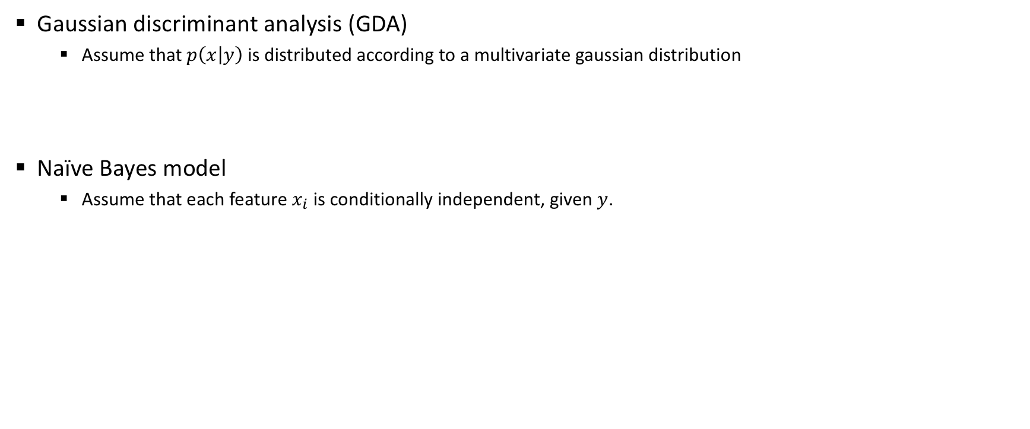
Examples of generative learning algorithms
Gaussian discriminant analysis (GDA)
Assume that $p\left(x | y\right)$ is distributed according to a multivariate gaussian distribution
Naïve Bayes model
Assume that each feature $x_{i}$ is conditionally independent, given $y$.

Slide 5
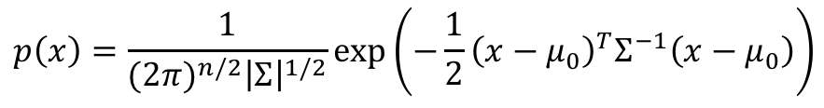
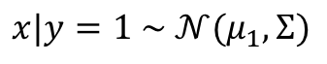
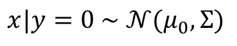
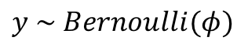
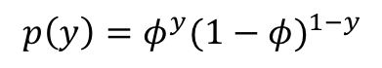
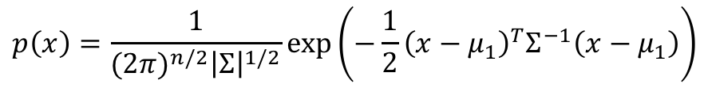
Gaussian discriminant analysis (GDA)
For features $x$ that are continuous-valued random variables, and $y∈\{0,1\}$
GDA models $p\left(x | y\right)$ using a multivariate gaussian distribution:
$$p\left(x\right)=\frac{1}{{(2π)}^{n/2}{\left|Σ\right|}^{1/2}}exp⁡\left(−\frac{1}{2}{\left(x−μ_{0}\right)}^{T}Σ^{−1}\left(x−μ_{0}\right)\right)$$
$$x|y=0 \sim 𝒩(μ_{0},Σ)$$
$$p\left(x\right)=\frac{1}{{(2π)}^{n/2}{\left|Σ\right|}^{1/2}}exp⁡\left(−\frac{1}{2}{\left(x−μ_{1}\right)}^{T}Σ^{−1}\left(x−μ_{1}\right)\right)$$
$$x|y=1 \sim 𝒩(μ_{1},Σ)$$
$$y \sim Bernoulli(φ)$$
$$p\left(y\right)=φ^{y}{(1−φ)}^{1−y}$$
Goal: Find the parameters that maximize the quantity $p\left(x | y\right)p(y)$

Slide 6
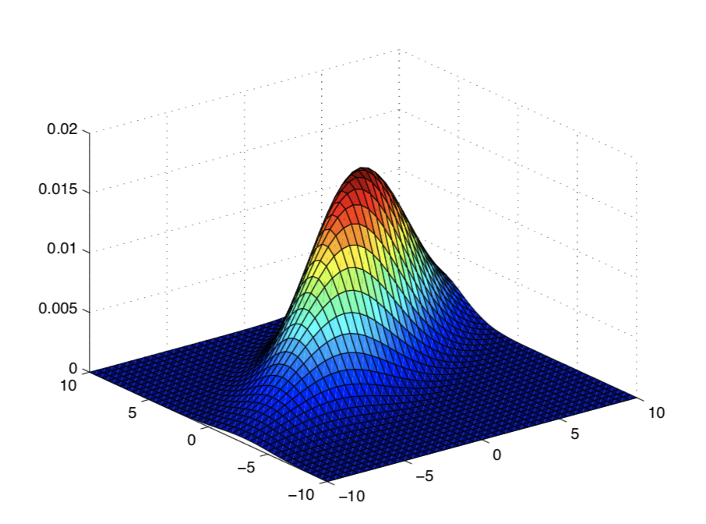
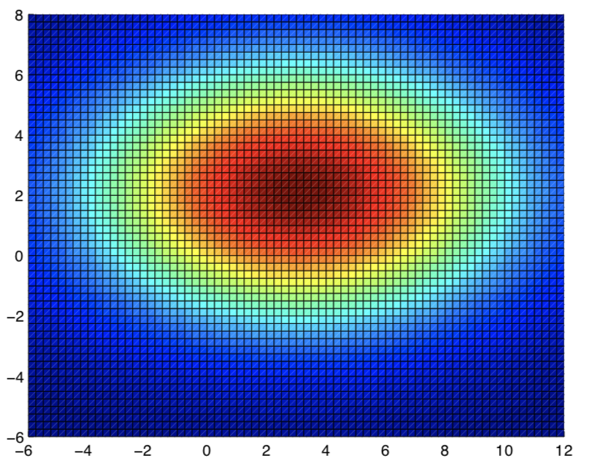
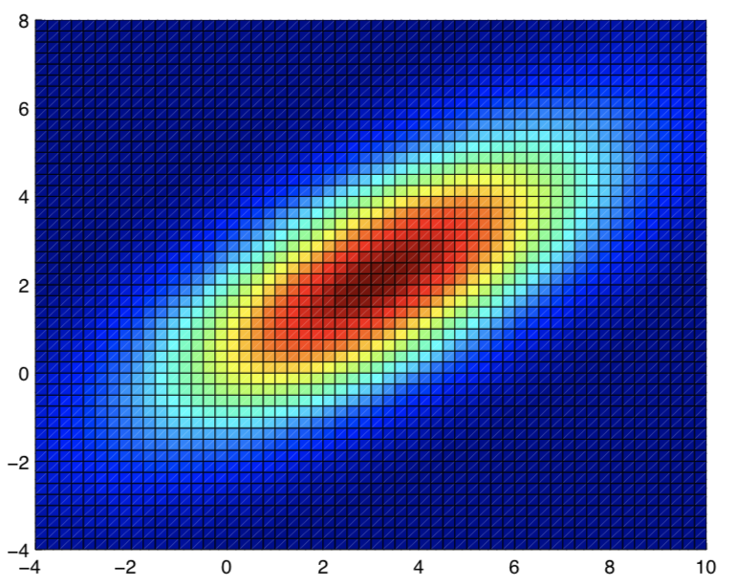
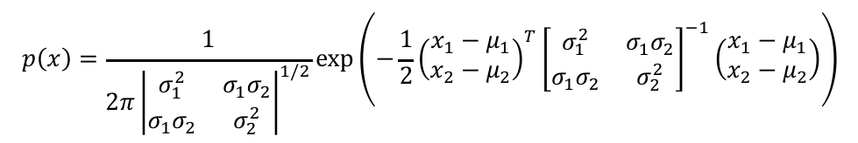
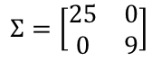
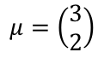
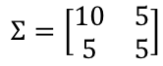
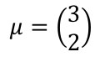
Gaussian distributions
$$p\left(x\right)=\frac{1}{2π{\left|\begin{matrix}σ_{1}^{2} & σ_{1}σ_{2} \\ σ_{1}σ_{2} & σ_{2}^{2}\end{matrix}\right|}^{1/2}}exp⁡\left(−\frac{1}{2}{\left(\begin{aligned}x_{1}−μ_{1} \\ x_{2}−μ_{2}\end{aligned}\right)}^{T}{\left[\begin{matrix}σ_{1}^{2} & σ_{1}σ_{2} \\ σ_{1}σ_{2} & σ_{2}^{2}\end{matrix}\right]}^{−1}\left(\begin{aligned}x_{1}−μ_{1} \\ x_{2}−μ_{2}\end{aligned}\right)\right)$$
$$μ=\left(\begin{aligned}3 \\ 2\end{aligned}\right)$$
$$Σ=\left[\begin{matrix}25 & 0 \\ 0 & 9\end{matrix}\right]$$
$$μ=\left(\begin{aligned}3 \\ 2\end{aligned}\right)$$
$$Σ=\left[\begin{matrix}10 & 5 \\ 5 & 5\end{matrix}\right]$$

Slide 7
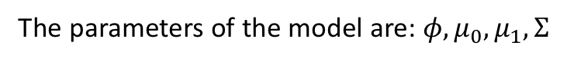
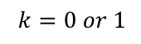
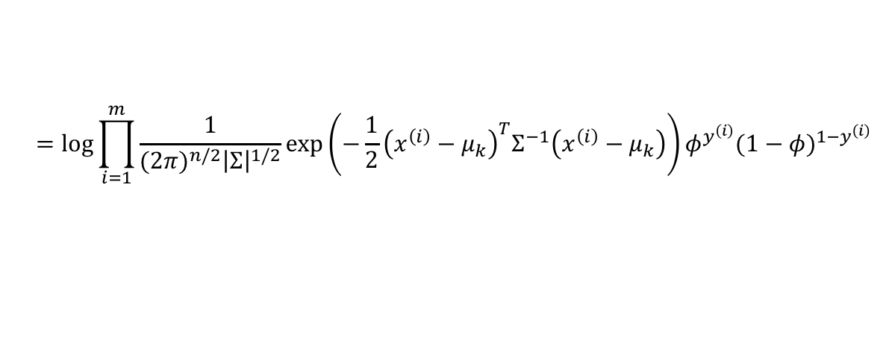
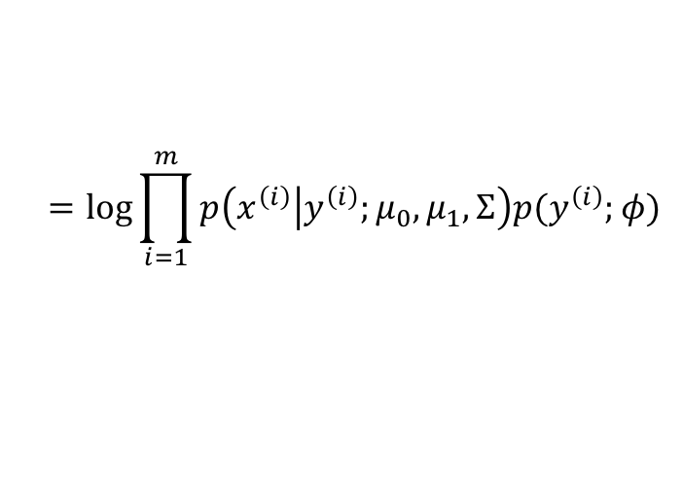
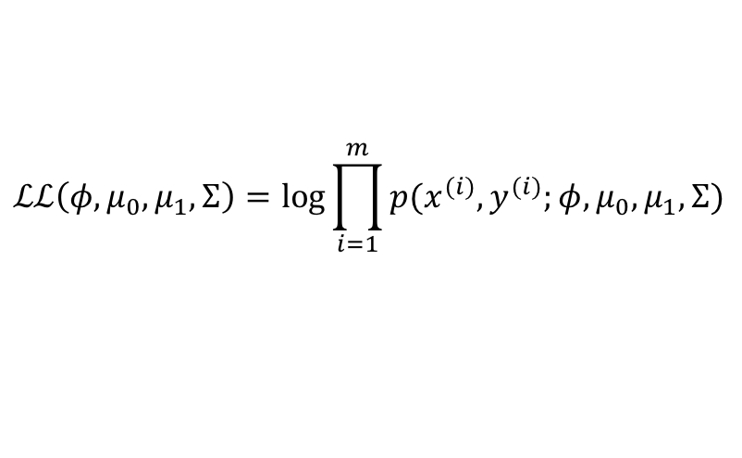
GDA: Log-likelihood
The parameters of the model are: $φ,μ_{0},μ_{1},Σ$
The log-likelihood of data:
$$ℒℒ\left(φ,μ_{0},μ_{1},Σ\right)=\log{\prod_{i=1}^{m}{p(x^{(i)},y^{(i)};φ,μ_{0},μ_{1},Σ)}}$$
Bayes rule
$$=\log{\prod_{i=1}^{m}{p\left(x^{\left(i\right)} | y^{\left(i\right)};μ_{0},μ_{1},Σ\right)p(y^{\left(i\right)};φ)}}$$
$$=\log{\prod_{i=1}^{m}{\frac{1}{{(2π)}^{n/2}{\left|Σ\right|}^{1/2}}exp⁡\left(−\frac{1}{2}{\left(x^{\left(i\right)}−μ_{k}\right)}^{T}Σ^{−1}\left(x^{\left(i\right)}−μ_{k}\right)\right)φ^{y^{\left(i\right)}}{(1−φ)}^{1−y^{\left(i\right)}}}}$$
$$k=0 or 1$$

Slide 8
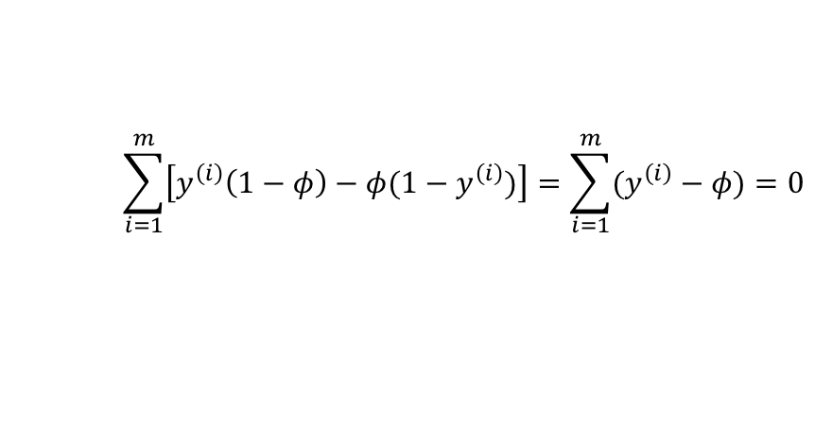
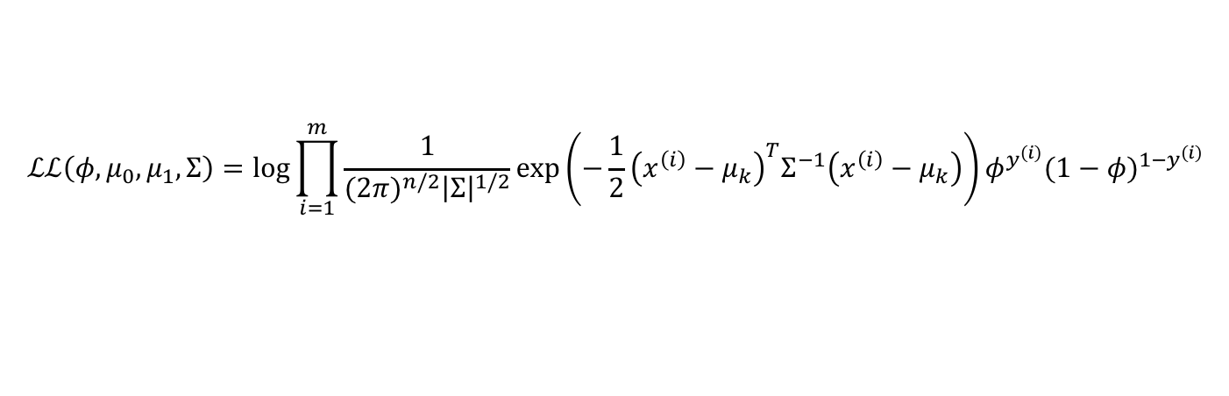
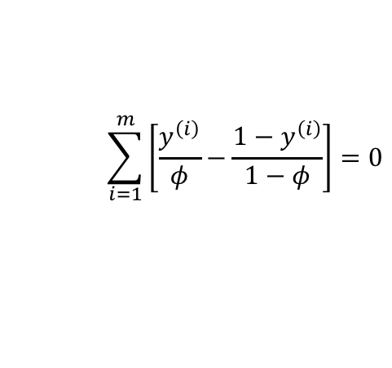
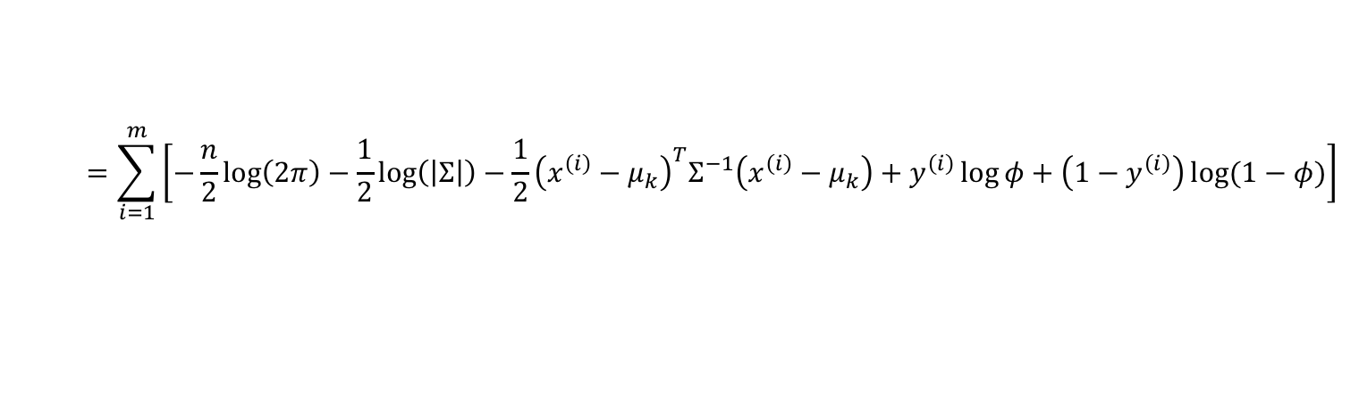
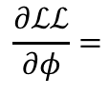
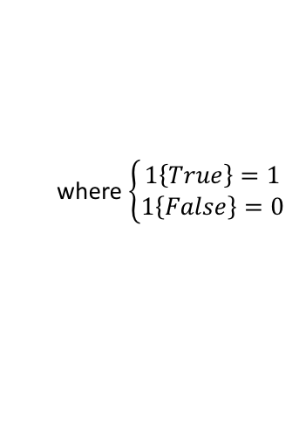
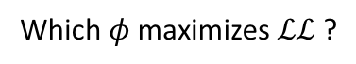
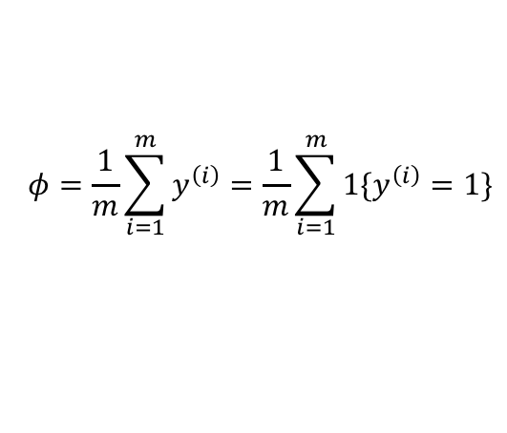
GDA: Maximize the log-likelihood
$$ℒℒ\left(φ,μ_{0},μ_{1},Σ\right)=\log{\prod_{i=1}^{m}{\frac{1}{{(2π)}^{n/2}{\left|Σ\right|}^{1/2}}exp⁡\left(−\frac{1}{2}{\left(x^{\left(i\right)}−μ_{k}\right)}^{T}Σ^{−1}\left(x^{\left(i\right)}−μ_{k}\right)\right)φ^{y^{\left(i\right)}}{(1−φ)}^{1−y^{\left(i\right)}}}}$$
$$=\sum_{i=1}^{m}{\left[−\frac{n}{2}\log\left(2π\right)−\frac{1}{2}\log\left(\left|Σ\right|\right)−\frac{1}{2}{\left(x^{\left(i\right)}−μ_{k}\right)}^{T}Σ^{−1}\left(x^{\left(i\right)}−μ_{k}\right)+y^{\left(i\right)}\log{φ}+\left(1−y^{\left(i\right)}\right)\log{(1−φ)}\right]}$$
Which $φ$ maximizes $ℒℒ$ ?
$$\frac{∂ℒℒ}{∂φ}=$$
$$\sum_{i=1}^{m}{\left[\frac{y^{\left(i\right)}}{φ}−\frac{1−y^{\left(i\right)}}{1−φ}\right]}=0$$
$$\sum_{i=1}^{m}{\left[y^{\left(i\right)}\left(1−φ\right)−φ(1−y^{\left(i\right)})\right]}=\sum_{i=1}^{m}{(y^{\left(i\right)}−φ)}=0$$
$$φ=\frac{1}{m}\sum_{i=1}^{m}{y^{\left(i\right)}}=\frac{1}{m}\sum_{i=1}^{m}{1\{y^{\left(i\right)}=1\}}$$
where $\left\{\begin{aligned}1\left\{True\right\}=1 \\ 1\left\{False\right\}=0\end{aligned}\right.$

Slide 9
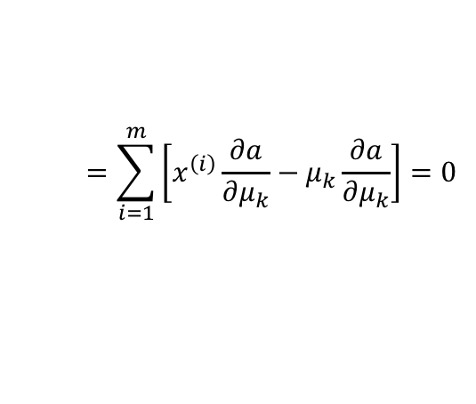
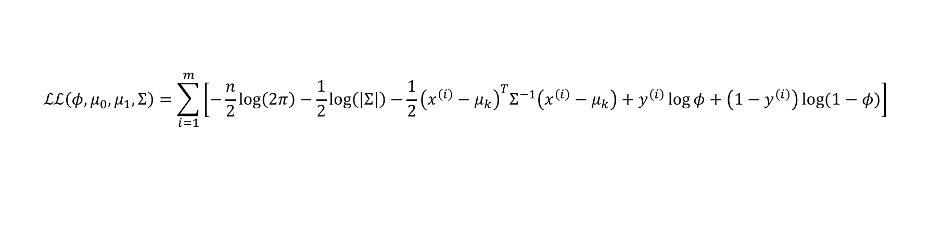
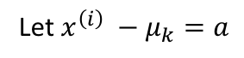
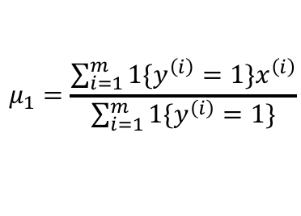
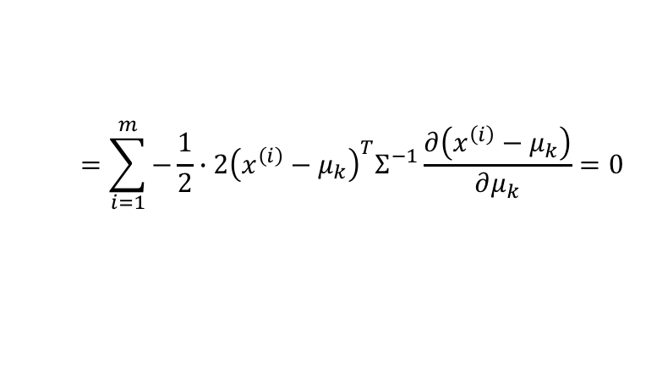
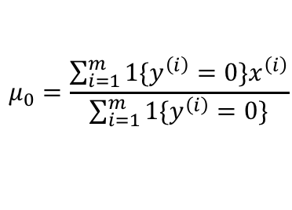
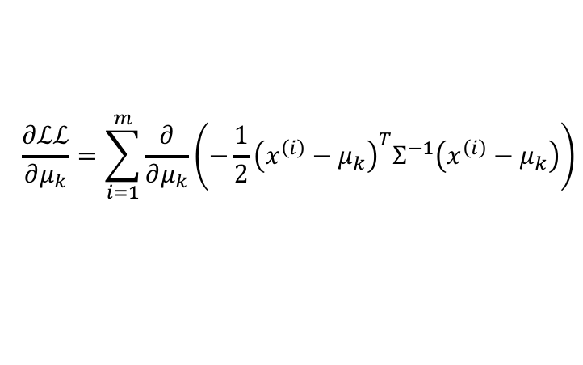
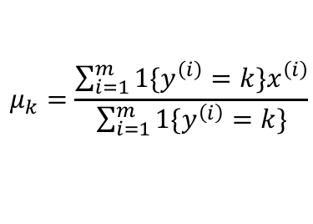
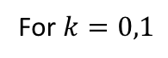
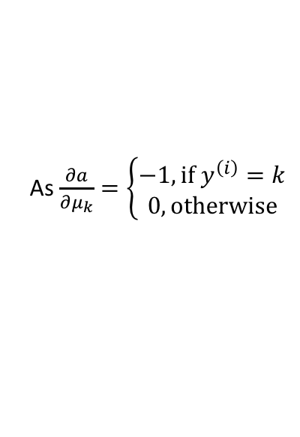
GDA: Maximize the log-likelihood (cont.)
$$ℒℒ\left(φ,μ_{0},μ_{1},Σ\right)=\sum_{i=1}^{m}{\left[−\frac{n}{2}\log\left(2π\right)−\frac{1}{2}\log\left(\left|Σ\right|\right)−\frac{1}{2}{\left(x^{\left(i\right)}−μ_{k}\right)}^{T}Σ^{−1}\left(x^{\left(i\right)}−μ_{k}\right)+y^{\left(i\right)}\log{φ}+\left(1−y^{\left(i\right)}\right)\log{(1−φ)}\right]}$$
For $k=0,1$
$$\frac{∂ℒℒ}{∂μ_{k}}=\sum_{i=1}^{m}{\frac{∂}{∂μ_{k}}}\left(−\frac{1}{2}{\left(x^{\left(i\right)}−μ_{k}\right)}^{T}Σ^{−1}\left(x^{\left(i\right)}−μ_{k}\right)\right)$$
$$=\sum_{i=1}^{m}{−\frac{1}{2}∙2{\left(x^{\left(i\right)}−μ_{k}\right)}^{T}Σ^{−1}\frac{∂\left(x^{\left(i\right)}−μ_{k}\right)}{∂μ_{k}}}=0$$
Let $x^{\left(i\right)} −μ_{k}=a$
$$=\sum_{i=1}^{m}{\left[x^{\left(i\right)}\frac{∂a}{∂μ_{k}}−μ_{k}\frac{∂a}{∂μ_{k}}\right]}=0$$
$$μ_{0}=\frac{\sum_{i=1}^{m}{1\{y^{\left(i\right)}=0\}x^{\left(i\right)}}}{\sum_{i=1}^{m}{1\{y^{\left(i\right)}=0\}}}$$
As $\frac{∂a}{∂μ_{k}}=\left\{\begin{aligned}−1, \text{if} y^{\left(i\right)}=k \\ 0, \text{otherwise}\end{aligned}\right.$
$$μ_{k}=\frac{\sum_{i=1}^{m}{1\{y^{\left(i\right)}=k\}x^{\left(i\right)}}}{\sum_{i=1}^{m}{1\{y^{\left(i\right)}=k\}}}$$
$$μ_{1}=\frac{\sum_{i=1}^{m}{1\{y^{\left(i\right)}=1\}x^{\left(i\right)}}}{\sum_{i=1}^{m}{1\{y^{\left(i\right)}=1\}}}$$

Slide 10
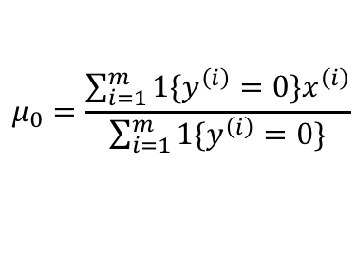
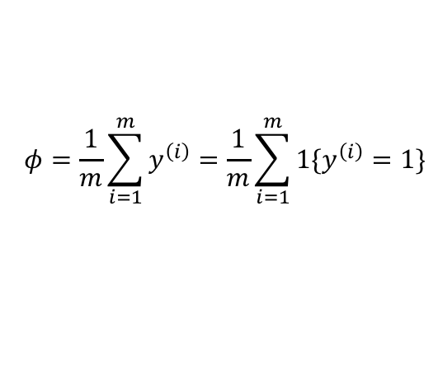
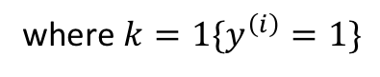




GDA: Maximize the log-likelihood (cont.)
$$ℒℒ\left(φ,μ_{0},μ_{1},Σ\right)=\sum_{i=1}^{m}{\left[−\frac{n}{2}\log\left(2π\right)−\frac{1}{2}\log\left(\left|Σ\right|\right)−\frac{1}{2}{\left(x^{\left(i\right)}−μ_{k}\right)}^{T}Σ^{−1}\left(x^{\left(i\right)}−μ_{k}\right)+y^{\left(i\right)}\log{φ}+\left(1−y^{\left(i\right)}\right)\log{(1−φ)}\right]}$$
$$\frac{∂ℒℒ}{∂Σ}=\sum_{i=1}^{m}{\left[\frac{∂}{∂Σ}\left(−\frac{1}{2}\log\left(\left|Σ\right|\right)\right)+\frac{∂}{∂Σ}\left(−\frac{1}{2}{\left(x^{\left(i\right)}−μ_{k}\right)}^{T}Σ^{−1}\left(x^{\left(i\right)}−μ_{k}\right)\right)\right]}=0$$
$$Σ=\frac{1}{m}\sum_{i=1}^{m}{\left(x^{\left(i\right)}−μ_{k}\right){\left(x^{\left(i\right)}−μ_{k}\right)}^{T}}$$
where $k=1\{y^{\left(i\right)}=1\}$
$$φ=\frac{1}{m}\sum_{i=1}^{m}{y^{\left(i\right)}}=\frac{1}{m}\sum_{i=1}^{m}{1\{y^{\left(i\right)}=1\}}$$
$$μ_{0}=\frac{\sum_{i=1}^{m}{1\{y^{\left(i\right)}=0\}x^{\left(i\right)}}}{\sum_{i=1}^{m}{1\{y^{\left(i\right)}=0\}}}$$
$$Σ=\frac{1}{m}\sum_{i=1}^{m}{\left(x^{\left(i\right)}−μ_{k}\right){\left(x^{\left(i\right)}−μ_{k}\right)}^{T}}$$
$$μ_{1}=\frac{\sum_{i=1}^{m}{1\{y^{\left(i\right)}=1\}x^{\left(i\right)}}}{\sum_{i=1}^{m}{1\{y^{\left(i\right)}=1\}}}$$

Slide 11



GDA: making predictions
For any new data $x$, can compute posterior $p\left(y=1 | x\right)$
Select the class that gives higher posterior
Decision boundary is where $p\left(y=1 | x\right)=0.5$

Slide 12









Naïve Bayes
What if features $x=\{x_{1},x_{2},⋯,x_{n}\}$ are categorical variables?
Email classification problem: $x$ is the text body of email, $y∈\{0,1\}$
Example: $x$ = [dear customer, … buy … product …]
Vocabulary $V$ = {a, about, an, …, buy, …, customer, …, dear,…, product, …}
$$\left|V\right|=10,000$$
$x$ = [0, 0, 0, …, 1, …, 0, 1, …, 0, 1, …,0, 1, ….]
$$x_{i}∈\{0,1\}$$
$$x_{1025}$$
$$x_{2364}$$
$$x_{3108}$$
$$x_{8568}$$
How to model $p(x|y)$?
Assume x is from a multinomial distribution over $2^{|V|}$ possible outcomes?
Infeasible!
Need to make simplified assumption of $x$

Slide 13




Naïve Bayes assumption
Assume that all feature components $x_{i}$ are conditionally independent given $y$
E.g., given y=1, whether “buy” appears in email will have no effect on whether “product” appears.
A strong assumption
Now we have:
$$p\left(x_{1},x_{2}⋯,x_{\left|V\right|} | y\right)=p\left(x_{1} | y\right)p\left(x_{2} | y\right)⋯p\left(x_{\left|V\right|} | y\right)=\prod_{j=1}^{\left|V\right|}{p\left(x_{j} | y\right)}$$
$$=\prod_{j=1}^{n}{p\left(x_{j} | y\right)}$$
Likelihood
Priori
Use parameters $φ_{j|y=0}$, $φ_{j|y=1}$, and $φ_{y}$:
$$φ_{j|y=0}=p(x_{j}=1|y=0)$$
$$φ_{j|y=1}=p(x_{j}=1|y=1)$$
$$φ_{y}=p(y=1)$$
To maximize the log-likelihood of data:
$$ℒℒ\left(φ_{y},φ_{j|y=0},φ_{j|y=1}\right)=\prod_{i=1}^{m}{p(x^{(i)},y^{(i)})}$$

Slide 14



Naïve Bayes solution
$$φ_{j|y=0}=\frac{\sum_{i=1}^{m}{1\{x_{j}^{\left(i\right)}=1∧y^{\left(i\right)}=0\}}}{\sum_{i=1}^{m}{1\{y^{\left(i\right)}=0\}}}$$
$$φ_{j|y=1}=\frac{\sum_{i=1}^{m}{1\{x_{j}^{\left(i\right)}=1∧y^{\left(i\right)}=1\}}}{\sum_{i=1}^{m}{1\{y^{\left(i\right)}=1\}}}$$
Number of times that word $x^{(i)}$ appears in a spam mail
Total number of spam mails
$$φ_{y}=\frac{\sum_{i=1}^{m}{1\{y^{\left(i\right)}=1\}}}{m}$$
Intuitively make sense!
For full proof, see: http://www.cs.columbia.edu/~mcollins/em.pdf

Slide 15



Naïve Bayes making predictions
Given a new email $\tilde{x}$
Simply calculate:
$$p\left(y=1 | \tilde{x}\right)=\frac{p\left(\tilde{x} | y=1\right)p(y=1)}{p(\tilde{x})}$$
$$=\frac{\left(\prod_{j=1}^{n}{p\left({\tilde{x}}_{j} | y=1\right)}\right)p(y=1)}{\left(\prod_{j=1}^{n}{p\left({\tilde{x}}_{j} | y=0\right)}\right)p\left(y=0\right)+\left(\prod_{j=1}^{n}{p\left({\tilde{x}}_{j} | y=1\right)}\right)p(y=1)}$$
Then pick whichever class has the higher posterior

Slide 16

Naïve Bayes: example 1
Text classification: sports or not
$$x$$ | $$y$$
“A great game” | Sports
“The election was over” | Not sports
“Very clean match” | Sports
“A clean but forgettable game” | Sports
“It was a close election” | Not sports
# of words in sports: 11
# of words in not sports: 9
# of unique words: 14
Given a new text “a very close game”, is it sports or not?

Slide 17
Naïve Bayes: example 1 (cont.)
P(S | “a very close game”) $∝$ P(“a very close game” | S) $×$ P(S)
= P(a | S) $×$ P(very | S) $×$ P(close | S) $×$ P(game | S) ) $×$ P(S)
P(NS| “a very close game”) $∝$ P(“a very close game” | NS) $×$ P(NS)
= P(a | NS) $×$ P(very | NS) $×$ P(close | NS) $×$ P(game | NS) ) $×$ P(NS)

Slide 18



Naïve Bayes: example 1 (cont.)
Smoothed word frequencies
Word | P(word | Sports) | P(word | Not Sports)
a | $$\frac{2+1}{11+14}$$ | $$\frac{1+1}{9+14}$$
very | $$\frac{1+1}{11+14}$$ | $$\frac{0+1}{9+14}$$
close | $$\frac{0+1}{11+14}$$ | $$\frac{1+1}{9+14}$$
game | $$\frac{2+1}{11+14}$$ | $$\frac{0+1}{9+14}$$
P(S | “a very close game”) = $2.76×{10}^{−5}$
P(NS | “a very close game”) = $0.572×{10}^{−5}$
Therefore, it is a sports message

Slide 19




Naïve Bayes: example 2
$x$: customer features
$y$: whether a customer will buy a computer
A new customer:
$\tilde{x}$ = [age ≤ 30,
income = medium,
student =yes,
credit_rating = fair]
Is she/he going to buy a computer?

Slide 20



Naïve Bayes: example 2 (cont.)
Likelihood
Priori
$$p\left(yes | \tilde{x}\right)∝p\left(\tilde{x} | yes\right)p(yes)$$
in which,
$$p\left(\tilde{x} | yes\right)=p\left(\text{age}\text{ ≤ 30} | yes\right)∙p\left(\text{income}\text{ = }\text{medium} | yes\right)∙$$
$$p(\text{student}\text{ =}\text{yes}|yes)∙p(\text{credit}\text{_}\text{rating}\text{ = }\text{fair}|yes)$$
Compare with:
$$p\left(no | \tilde{x}\right)∝p\left(\tilde{x} | no\right)p(no)$$

Slide 21









Naïve Bayes: example 2 (cont.)
Priori: $p\left(yes\right)=\frac{9}{14}=0.643$
Likelihood:
$$p\left(\text{age}\text{ ≤ 30} | yes\right)=2/9$$
$$p\left(\text{income}\text{ ≤ }\text{medium} | yes\right)=4/9$$
$$p\left(\text{student}\text{ ≤ }\text{yes} | yes\right)=6/9$$
$$p\left(\text{credit}\text{_}\text{rating}\text{ ≤ }\text{fair} | yes\right)=6/9$$
$$p\left(\tilde{x} | yes\right)=\frac{2}{9}∙\frac{4}{9}∙\frac{6}{9}∙\frac{6}{9}=0.044$$
Posterior:
$$p\left(yes | \tilde{x}\right)∝p\left(\tilde{x} | yes\right)p\left(yes\right)=0.028$$
$$p\left(no | \tilde{x}\right)∝p\left(\tilde{x} | no\right)p\left(no\right)=0.007$$
Therefore, customer $\tilde{x}$ is more likely to buy a computer

Slide 22

Generative Adversarial Networks (GANs)
Goodfellow et al. (2014)
How to build machine learning models that understand the world?
If a model is able to generate “good” data, then we claim that it understands the world (partially, at least)
Two neural networks involved: a generator and a discriminator
Real data
$$x$$
DNN/CNN
Predict whether the generated data is authentic (1) or fake (0)
Random input
DNN/CNN
$$x′$$
Fake data
$$z$$
Generator network
Notes:
The goal of the generator is to generate passable hand-written digits, to lie without being caught.
The goal of the discriminator is to identify images coming from the generator as fake.
Think of a GAN as the combination of a counterfeiter and a policeman in a game of cat and mouse,
where the counterfeiter is learning to pass false notes, and the policeman is learning to detect them.
Both are dynamic; i.e. the policeman is in training, and each side comes to learn the other’s methods in a constant escalation.

Slide 23

GANs example: generate hand-written digits
Regular convolutional NN
Deconvolutional NN (or, inverse CNN)

Slide 24









Training a GAN
$$x \sim p_{\text{data}}(x)$$
Real data
$$x$$
$D(x)$: probability that x came from $p_{\text{data}}$ rather than $p_{g}$
A cat and mouse game between $D$ and $G$
DNN/CNN
Train D to maximize $\log{D(x)}$
Random input
$$D(x;θ_{d})$$
DNN/CNN
$$x′$$
Fake data
$$\min_{G}{\max_{D}{V\left(D,G\right)}}=𝔼_{x\sim p_{data}(x) }\left[\log{D\left(x\right)}\right]+𝔼_{z\sim p_{z}(z) }\left[\log\left(1−G(z)\right)\right]$$
$$z$$
Generator network
$$x^{′}=G\left(z\right)\sim p_{g}$$
$$z \sim p_{z}(z)$$
$$G(z;θ_{g})$$
Train G to minimize $\log\left(1−G(z)\right)$

Slide 25












Illustration
…
$$G(z)$$
$$p_{g}$$
After training $D$
After training $G$
After enough steps
$$p_{data}$$
$$D\left(x\right)=0.5$$
$$D$$
$D$ is unable to discriminate $p_{g}$ from $p_{data}$

Slide 26

Training steps breakdown
Step 1: Train discriminator $D$ on real data
Step 2: Generate fake data using generator $G$ and train $D$ on them
Note: At this step $G$ is frozen (not updated)
Step 3: Train $G$ using the predictions of $D$
Note: At this step $D$ is frozen
Repeat the steps for a few epochs until the fake data seem legit (manually check)

Slide 27

Output of the generator network
Figures from Goodfellow et al. (2014)

Slide 28
Output of the generator network
Landscape
Portrait

Slide 29
Challenges with GANs
Stability issue
If the discriminator is too powerful, the generator would fail to train
If the discriminator is too lenient, any image would be generated
Wholistic convergence issue
D and G are dependent on each other. If one fails, the whole system fails

Slide 30



Challenges with GANs (cont.)

